Slide 2


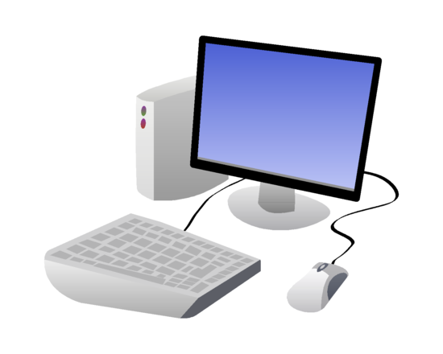
Account Policies
Set of configuration parameters
User accounts
Computer accounts
Notes:
Could be Users,
Machines, service accounts fall under the NPE designation

Slide 3
Access Policies
Conditions granting or denying access
Network location
Time-based
IP address
Subnet
Notes:
Could be Users,
Machines, service accounts fall under the NPE designation

Slide 4
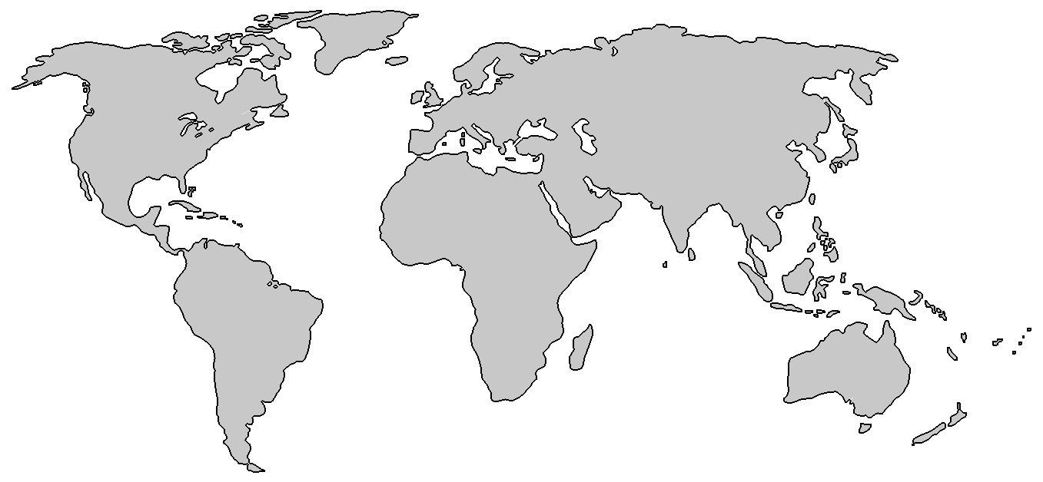

Geolocation
Identifying users based on location
Notes:
Mention impossible travel time here

Slide 5

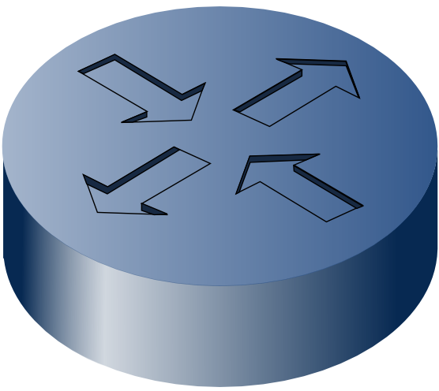
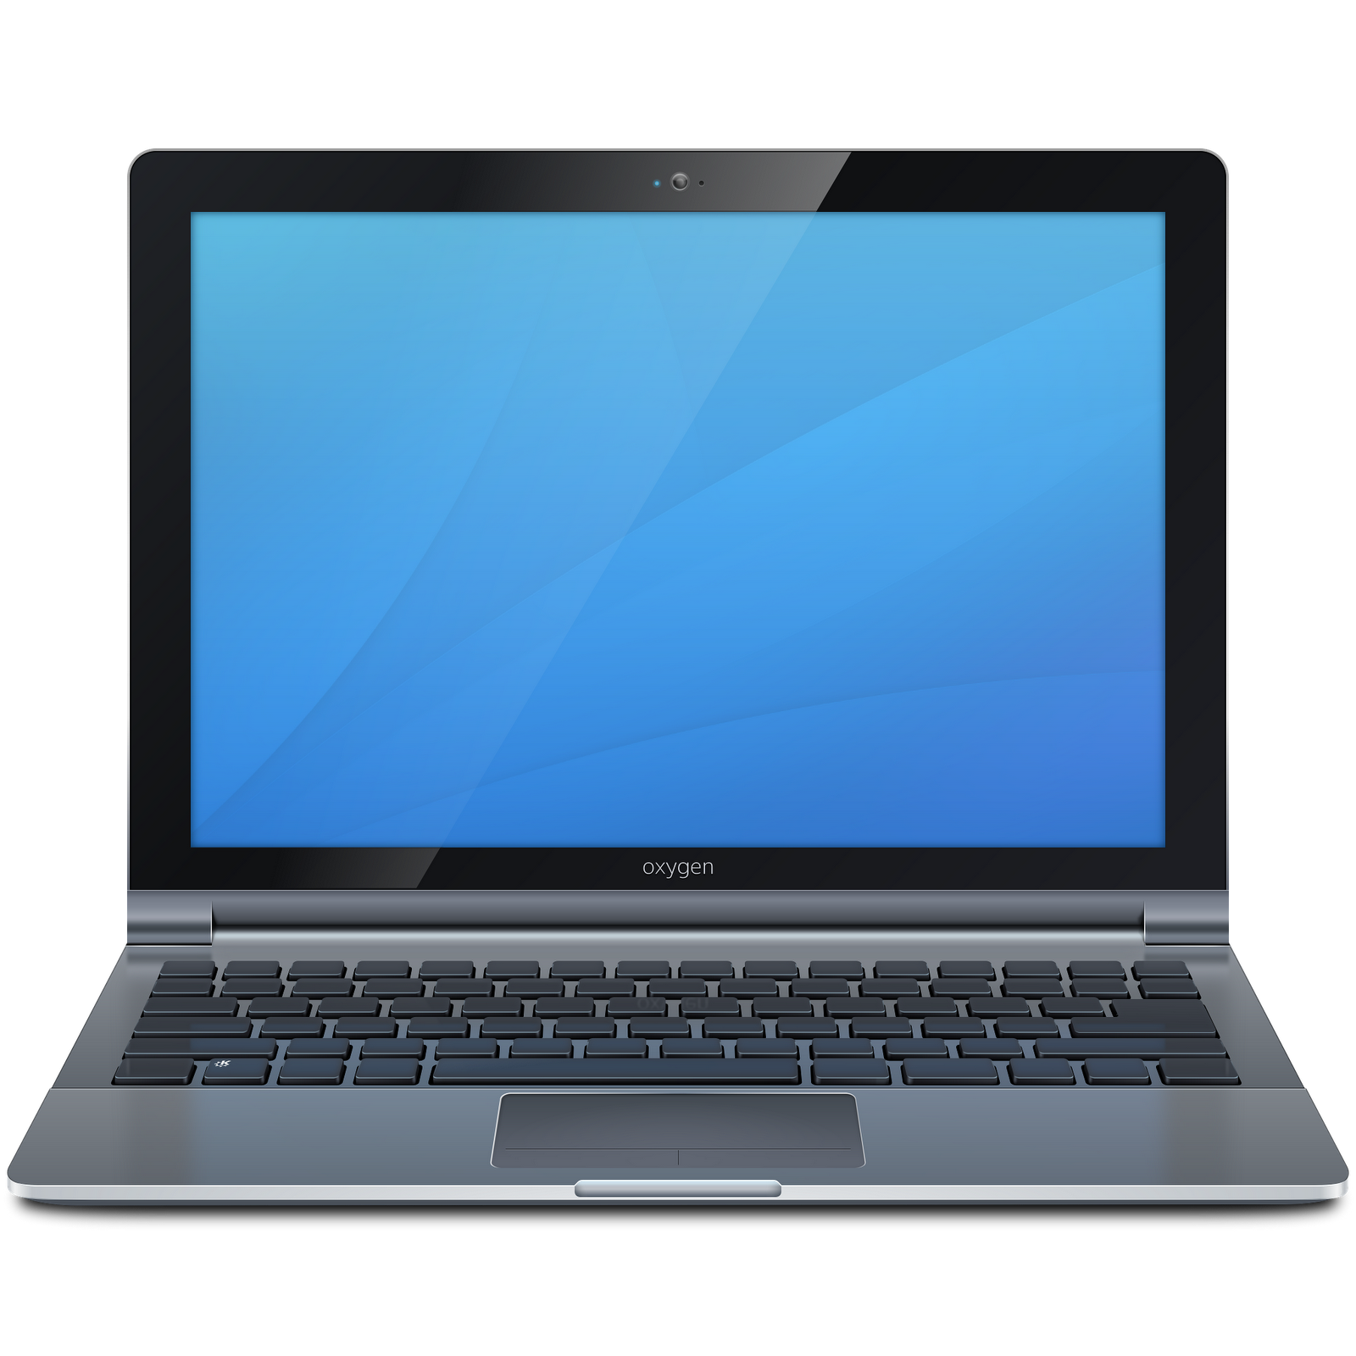

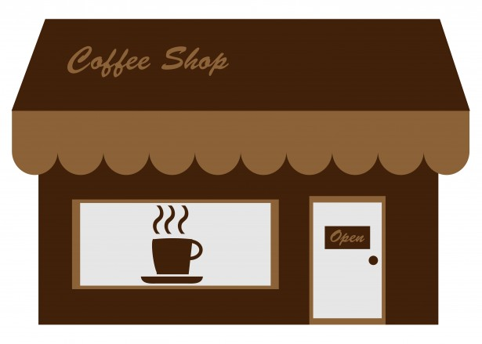
Geofencing
Location-based logical boundaries
Main Office
Branch Office
Internet

Slide 6
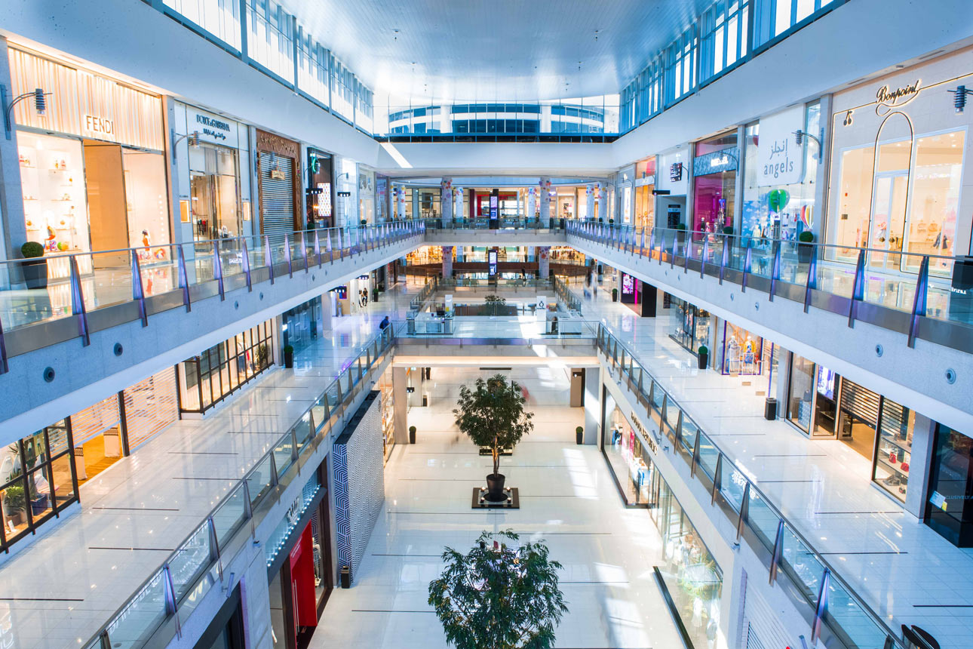
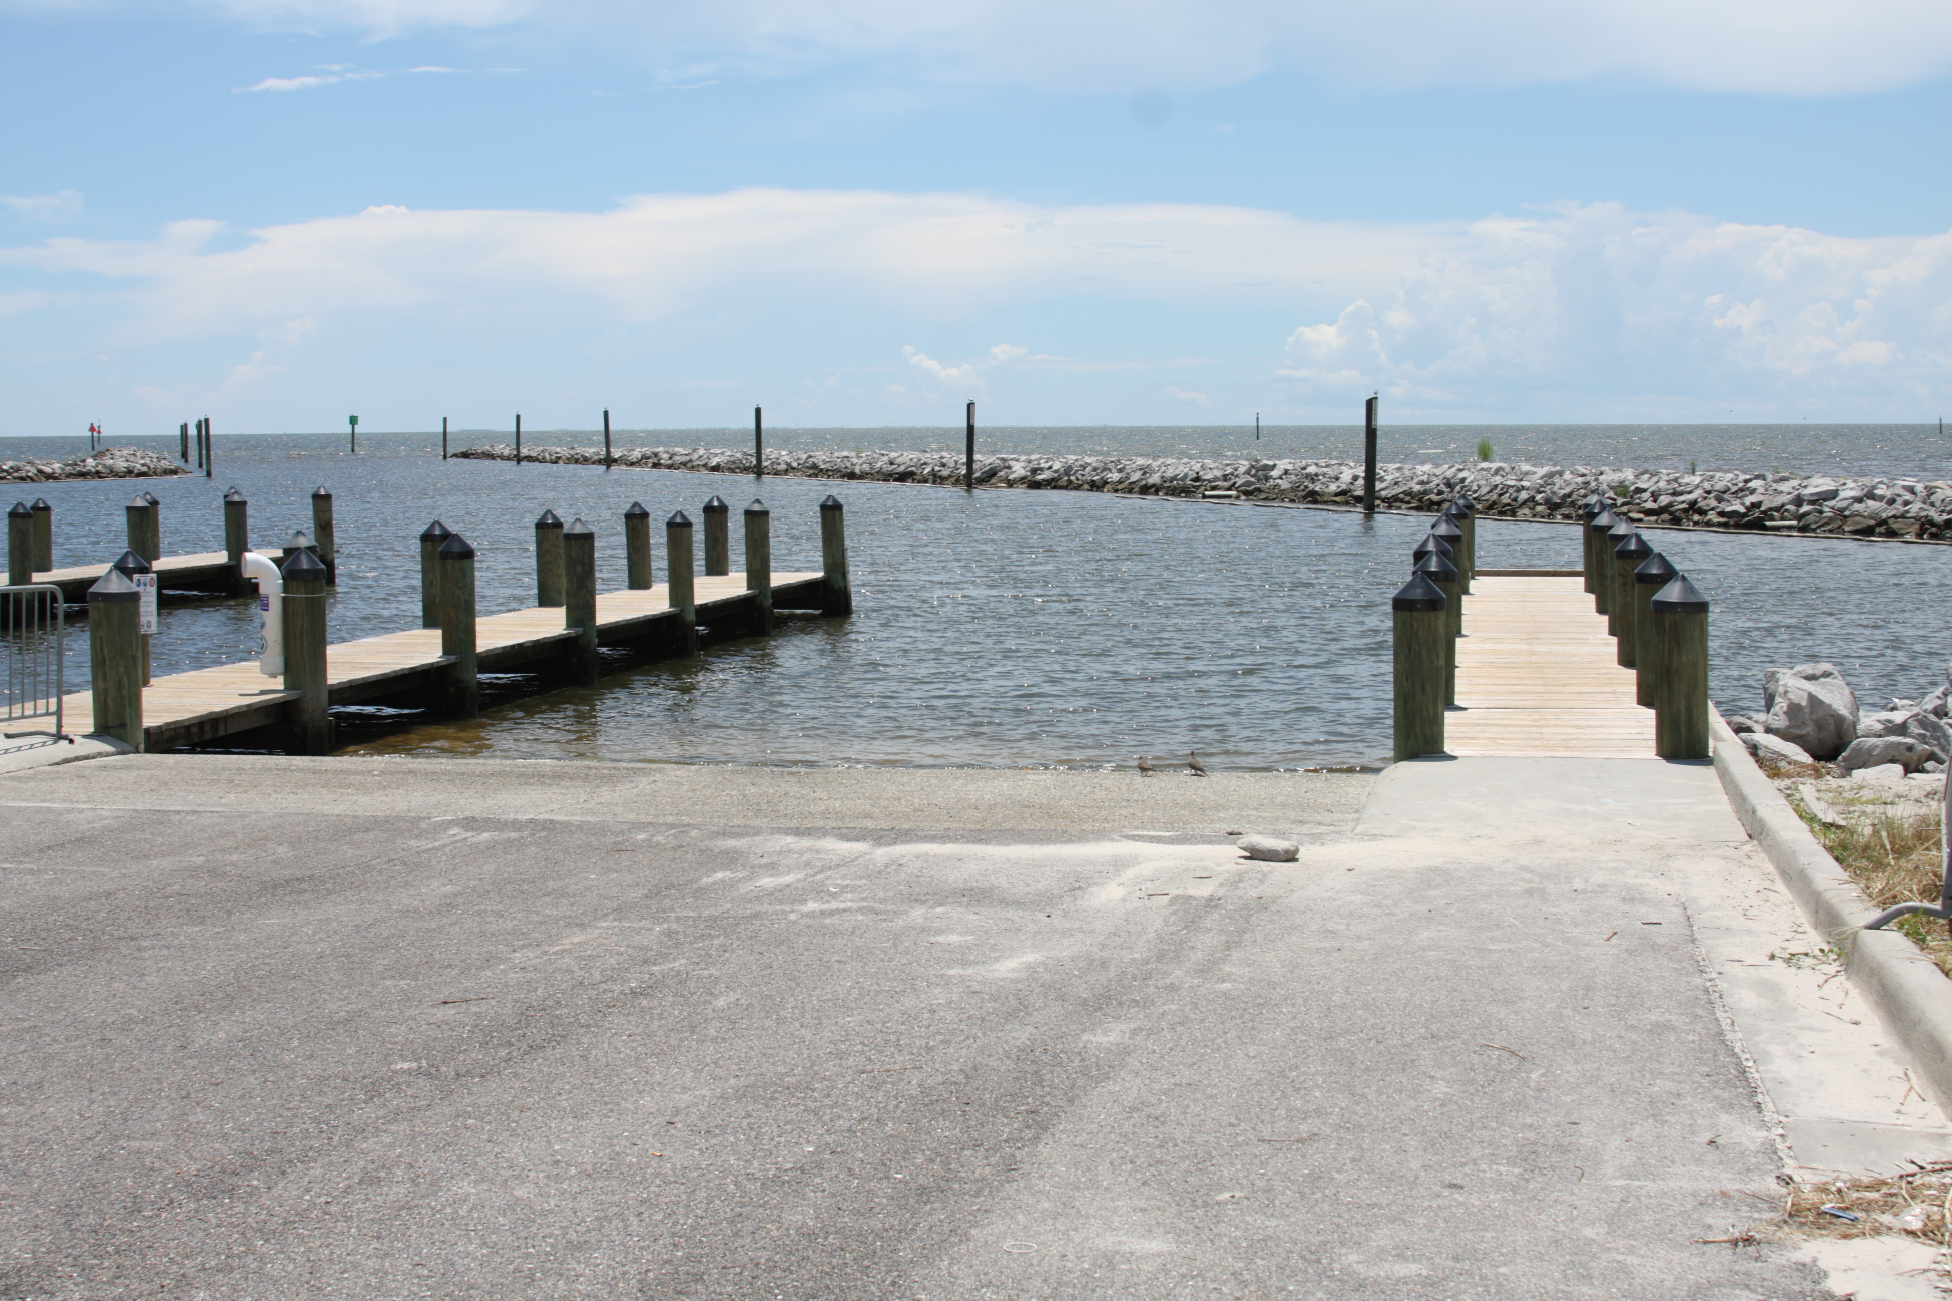
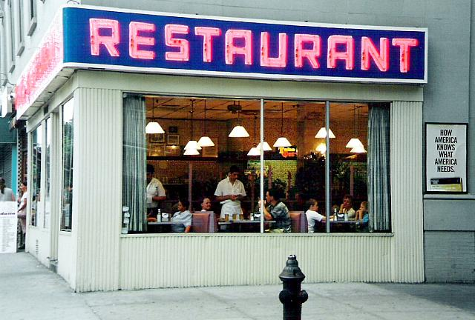
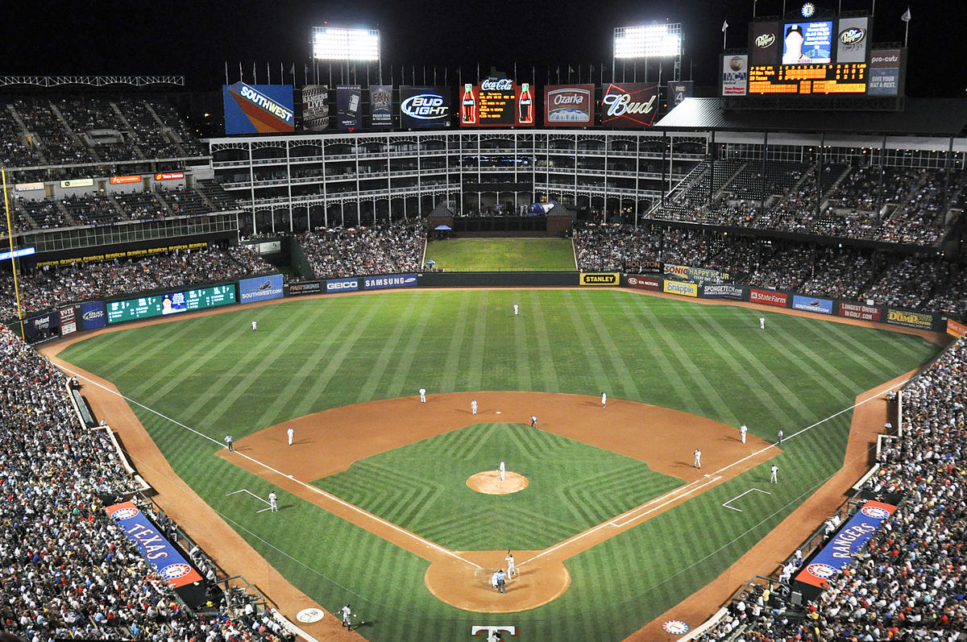
Geotagging
Attaching location-based metadata
Notes:
Could be Users,
Machines, service accounts fall under the NPE designation

